Slide 1
Tutorial machine learning in solid mechanics
Task 3 – Viscoelasticity
Notes:
Hello, today I would like to present you the second task
sheet which deals with the modeling of hyperelasticity

Slide 2
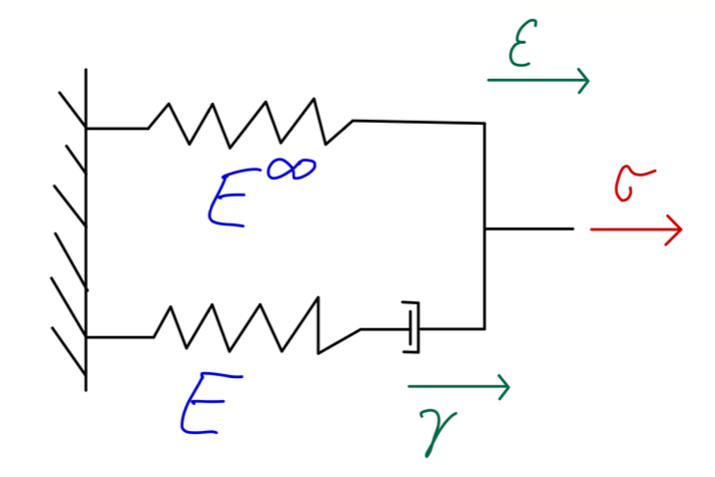
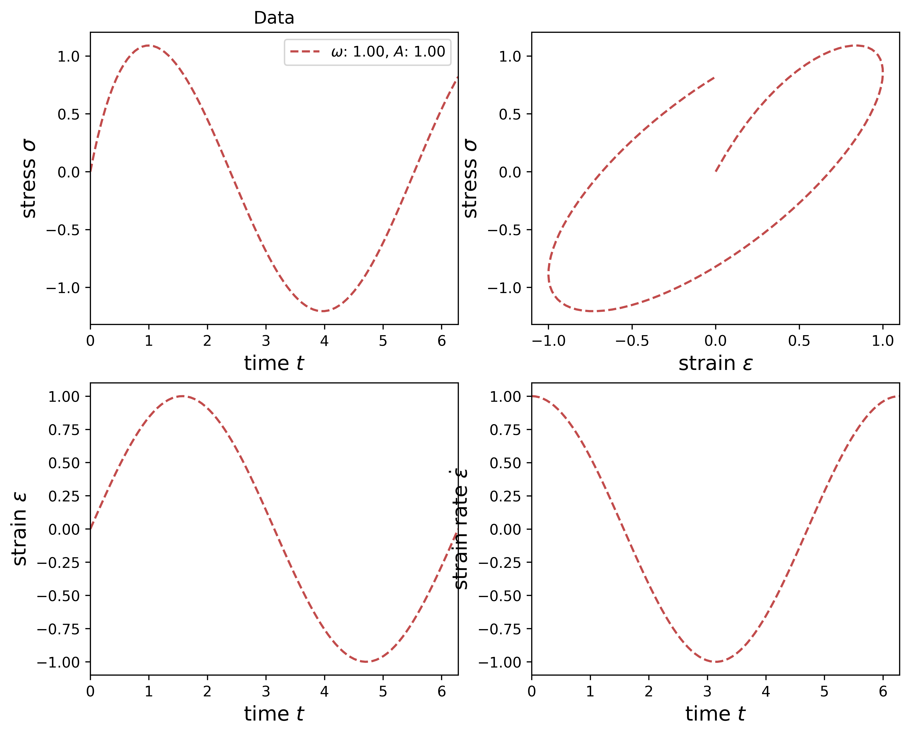
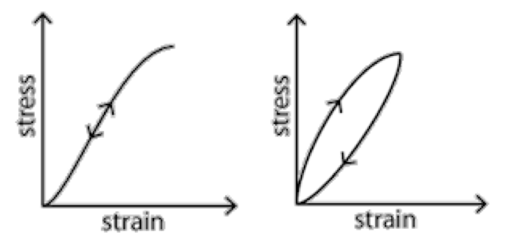
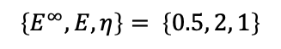
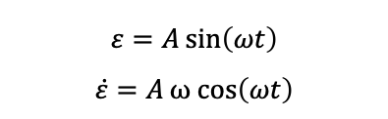

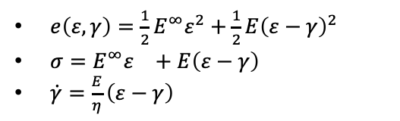
Introduction
Simple RNN
Maxwell Model
Generalized Standard Materials
summary
So far we have dealt with elastic materials (dissipation free)
Now we consider inelastic materials
Energy is dissipated
Stress-strain relation is rate- or path-dependent
Maxwell model for describing the viscoelastic behavior of materials
Maxwell model:
Harmonic oscillation:
Explicit euler scheme:
$e\left(ε,γ\right)=\frac{1}{2}E^{∞}ε^{2}+\frac{1}{2}E{\left(ε−γ\right)}^{2}$
$σ=E^{∞}ε^{}+E{\left(ε−γ\right)}^{}$
$\dot{γ}=\frac{E}{η}{\left(ε−γ\right)}^{}$
$$γ_{n+1}=γ_{n}+∆t_{n}\frac{E}{η}\left(ε_{n}−γ_{n}\right)$$
Parameters:
$$\left\{E^{∞}, E, η\right\}= \left\{0.5, 2, 1\right\}$$
$$ε=A\sin\left(ωt\right)$$
$$\dot{ε}=Aω cos\left(ωt\right)$$
Notes:
-The first task consisted mainly of data preparation and data visualization
The data is generated synthetically by evaluating a hyperelastic potential
The dataset consists of triplets for the corresponding deformation gradient tensor F, the Stress tensor, and the strain energy density
We have different kind of deformation: uniaxial, biaxial, shear, mixed
A uniaxial load path is shown here as an example

Slide 3
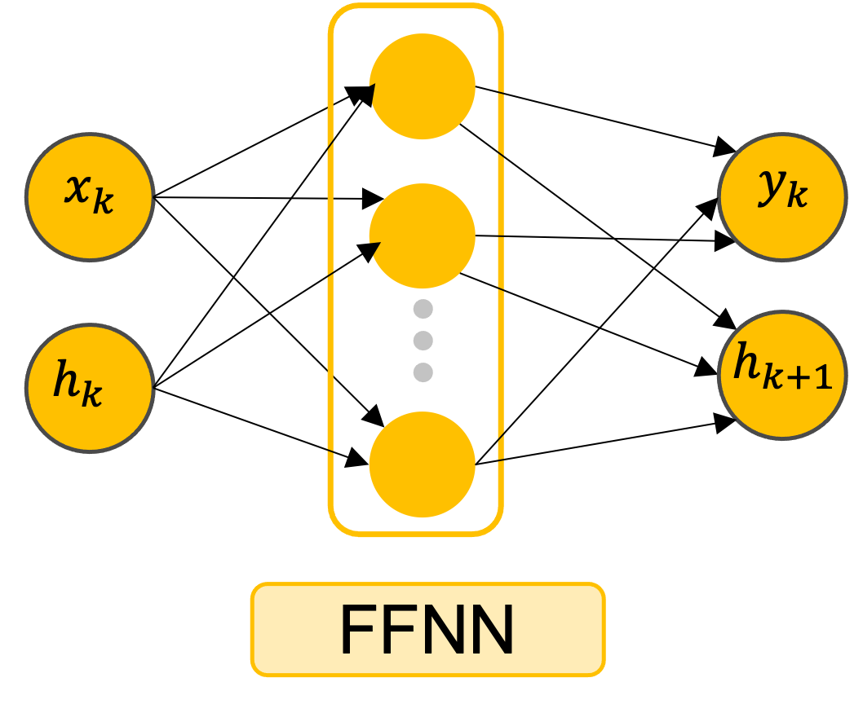
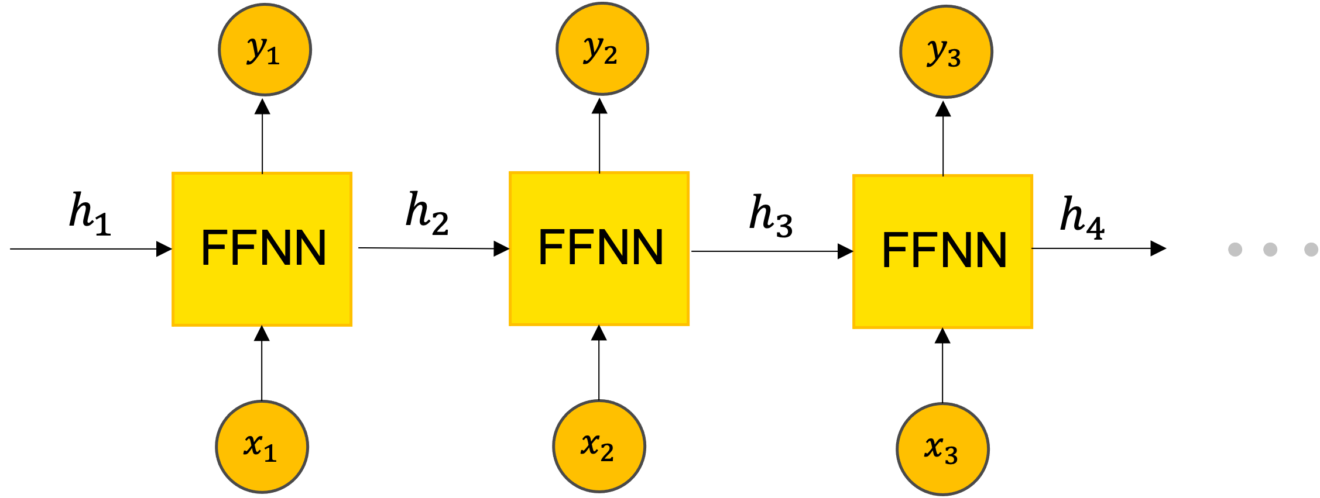
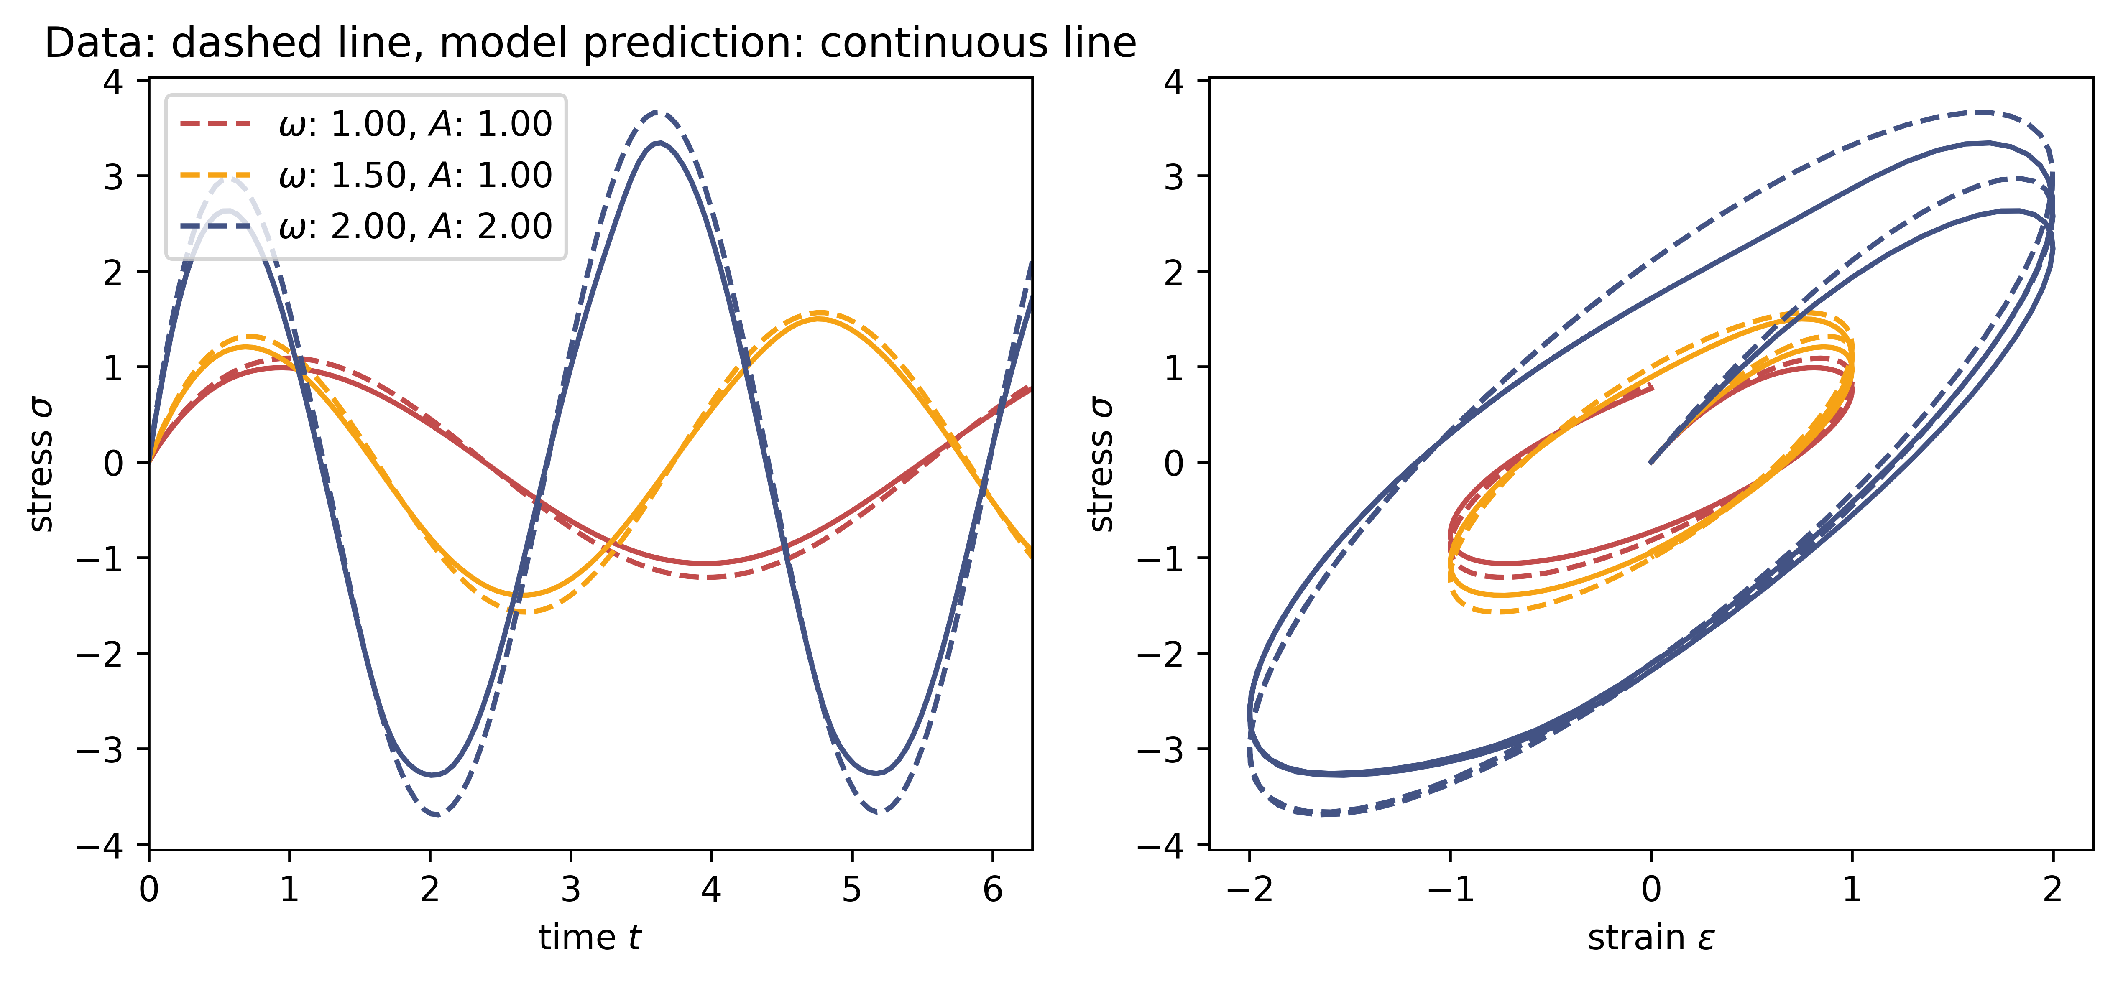
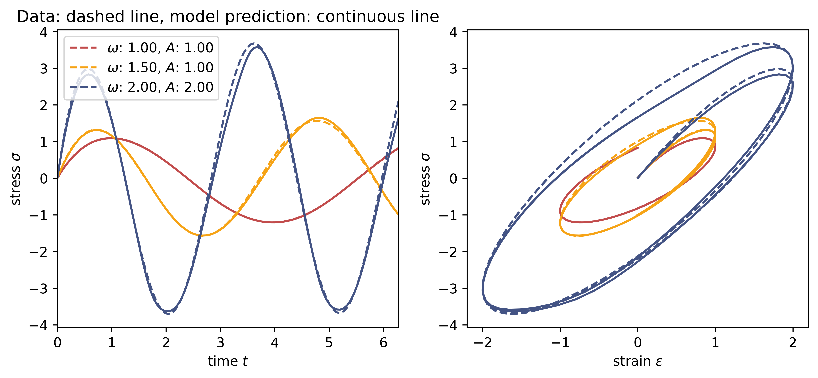
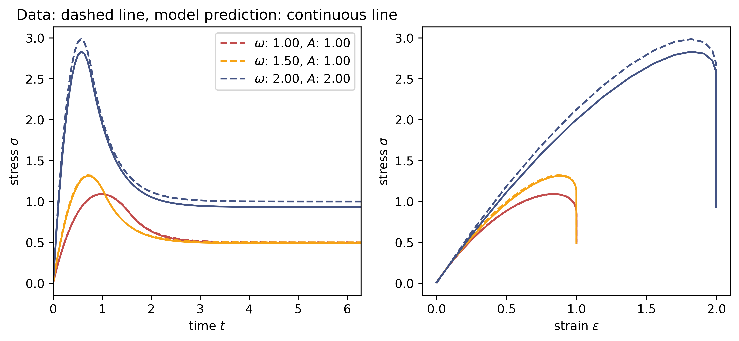
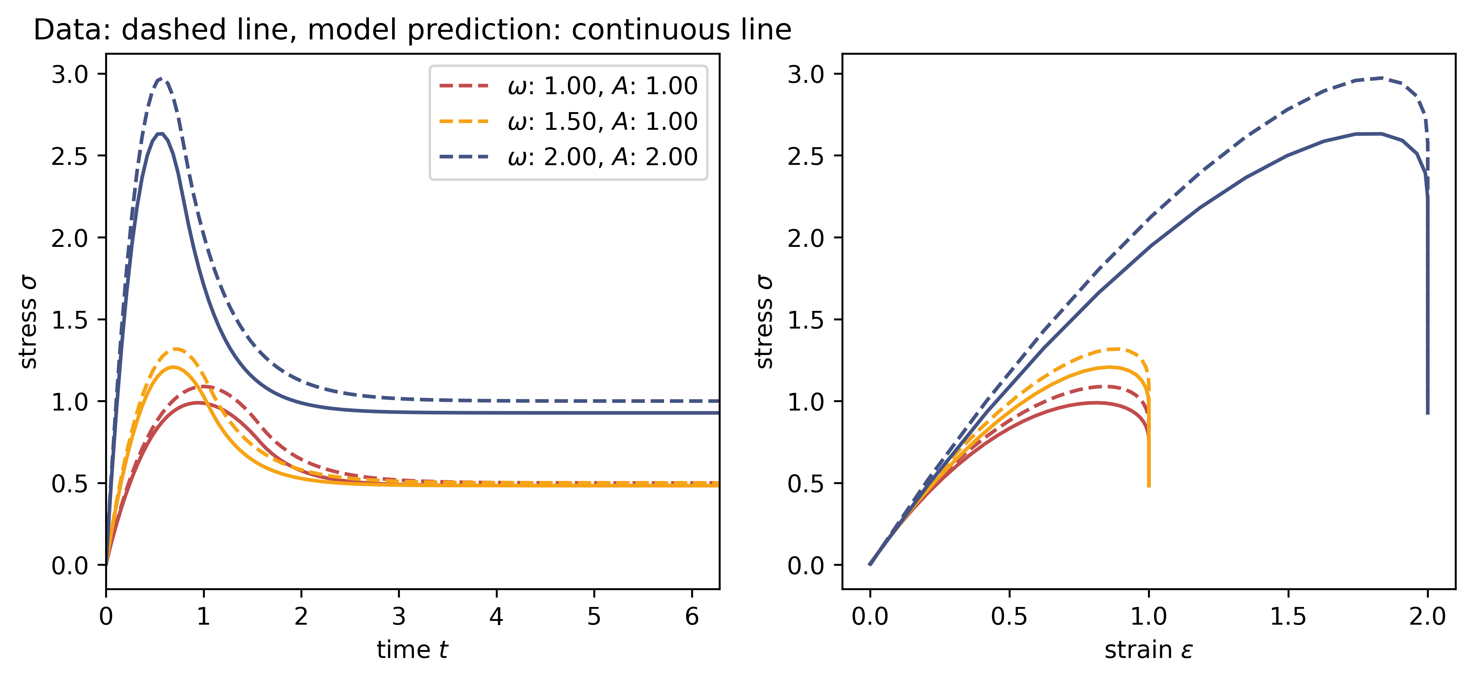
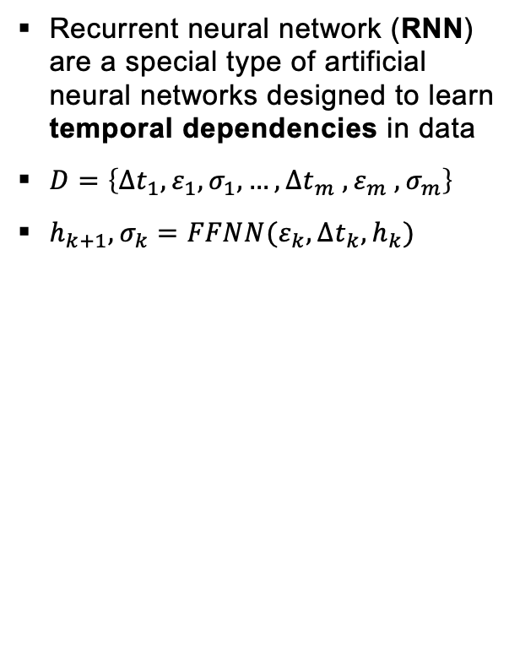
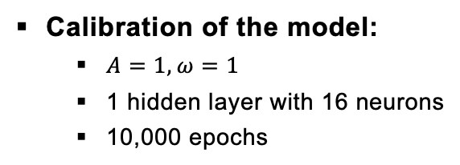
Introduction
Simple RNN
Maxwell Model
Generalized Standard Materials
summary
Recurrent neural network (RNN) are a special type of artificial neural networks designed to learn temporal dependencies in data
$D=\left\{∆t_{1}, ε_{1}, σ_{1}, …,∆t_{m} , ε_{m} , σ_{m}\right\}$
$h_{k+1}, σ_{k}=FFNN(ε_{k},∆t_{k}, h_{k})$
Calibration of the model:
$A=1, ω=1$
1 hidden layer with 16 neurons
10,000 epochs
Model without any prior knowlegde
Extrapolation behavior acceptable
Predictions depend on time step size
Not useful to solve real world problems!
Notes:
-The first task consisted mainly of data preparation and data visualization
The data is generated synthetically by evaluating a hyperelastic potential
The dataset consists of triplets for the corresponding deformation gradient tensor F, the Stress tensor, and the strain energy density
We have different kind of deformation: uniaxial, biaxial, shear, mixed
A uniaxial load path is shown here as an example

Slide 4
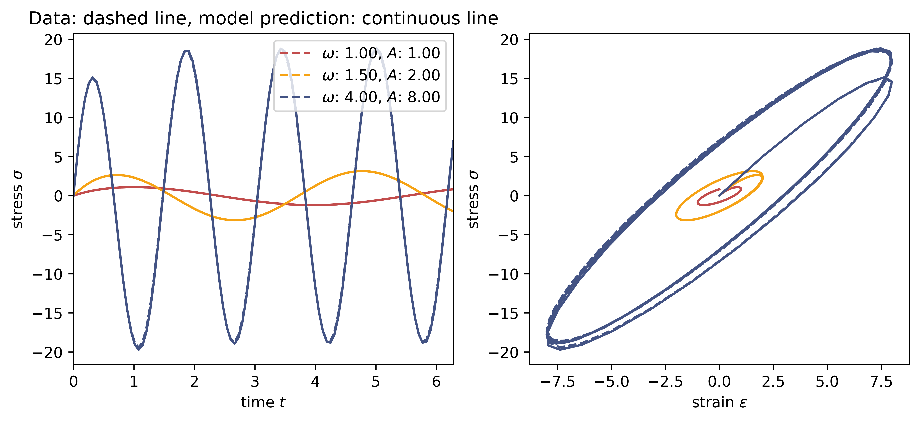
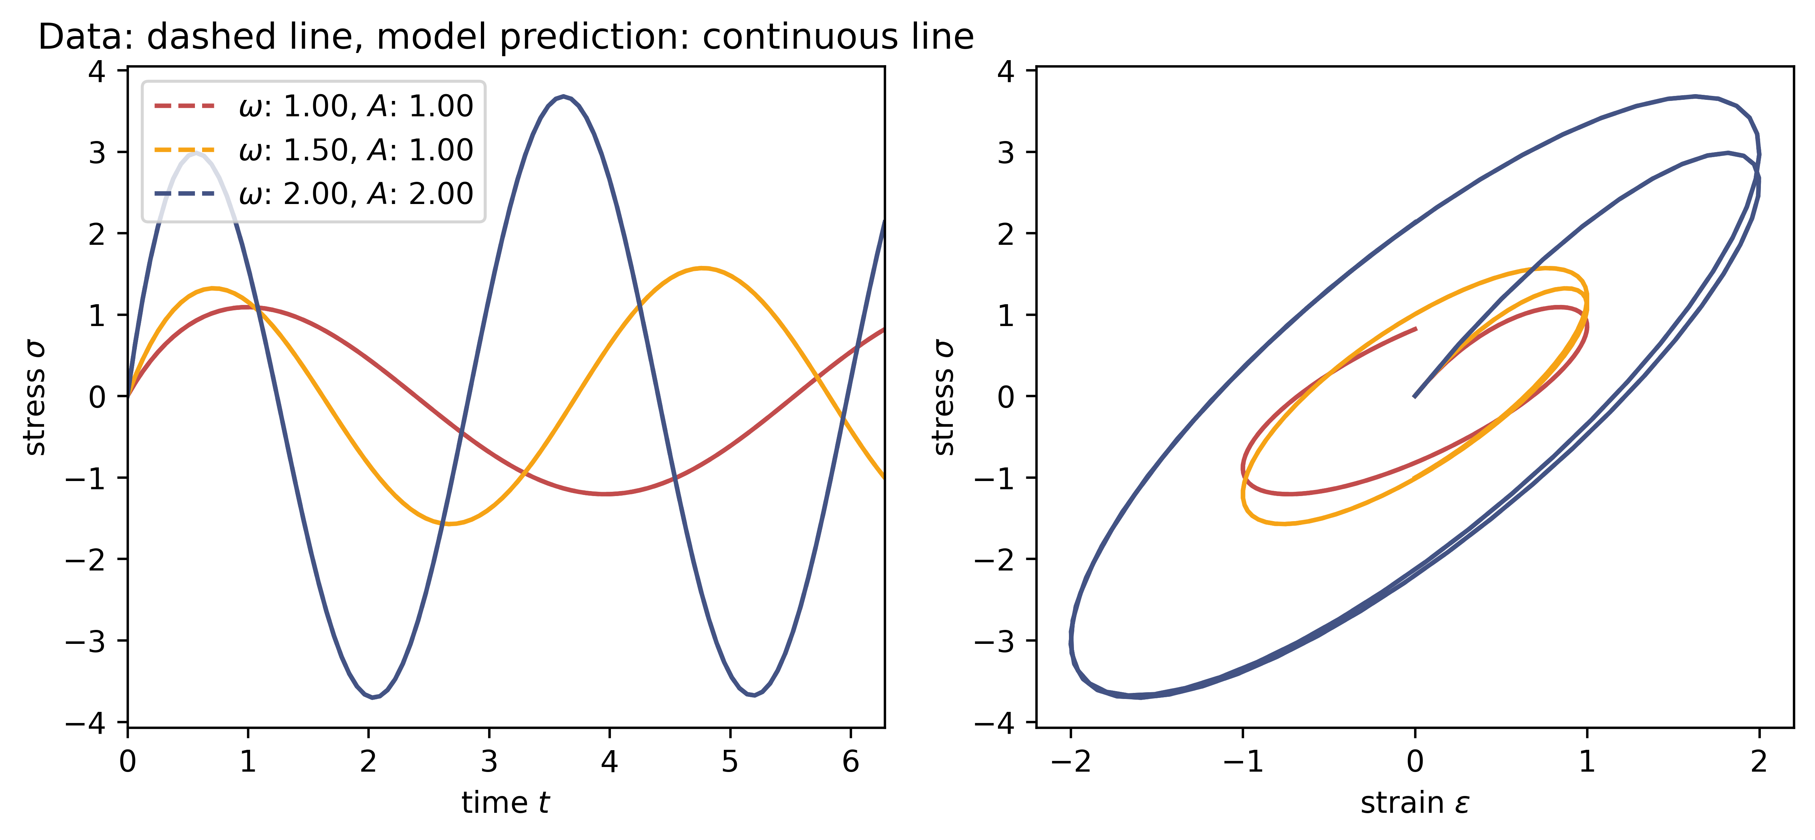
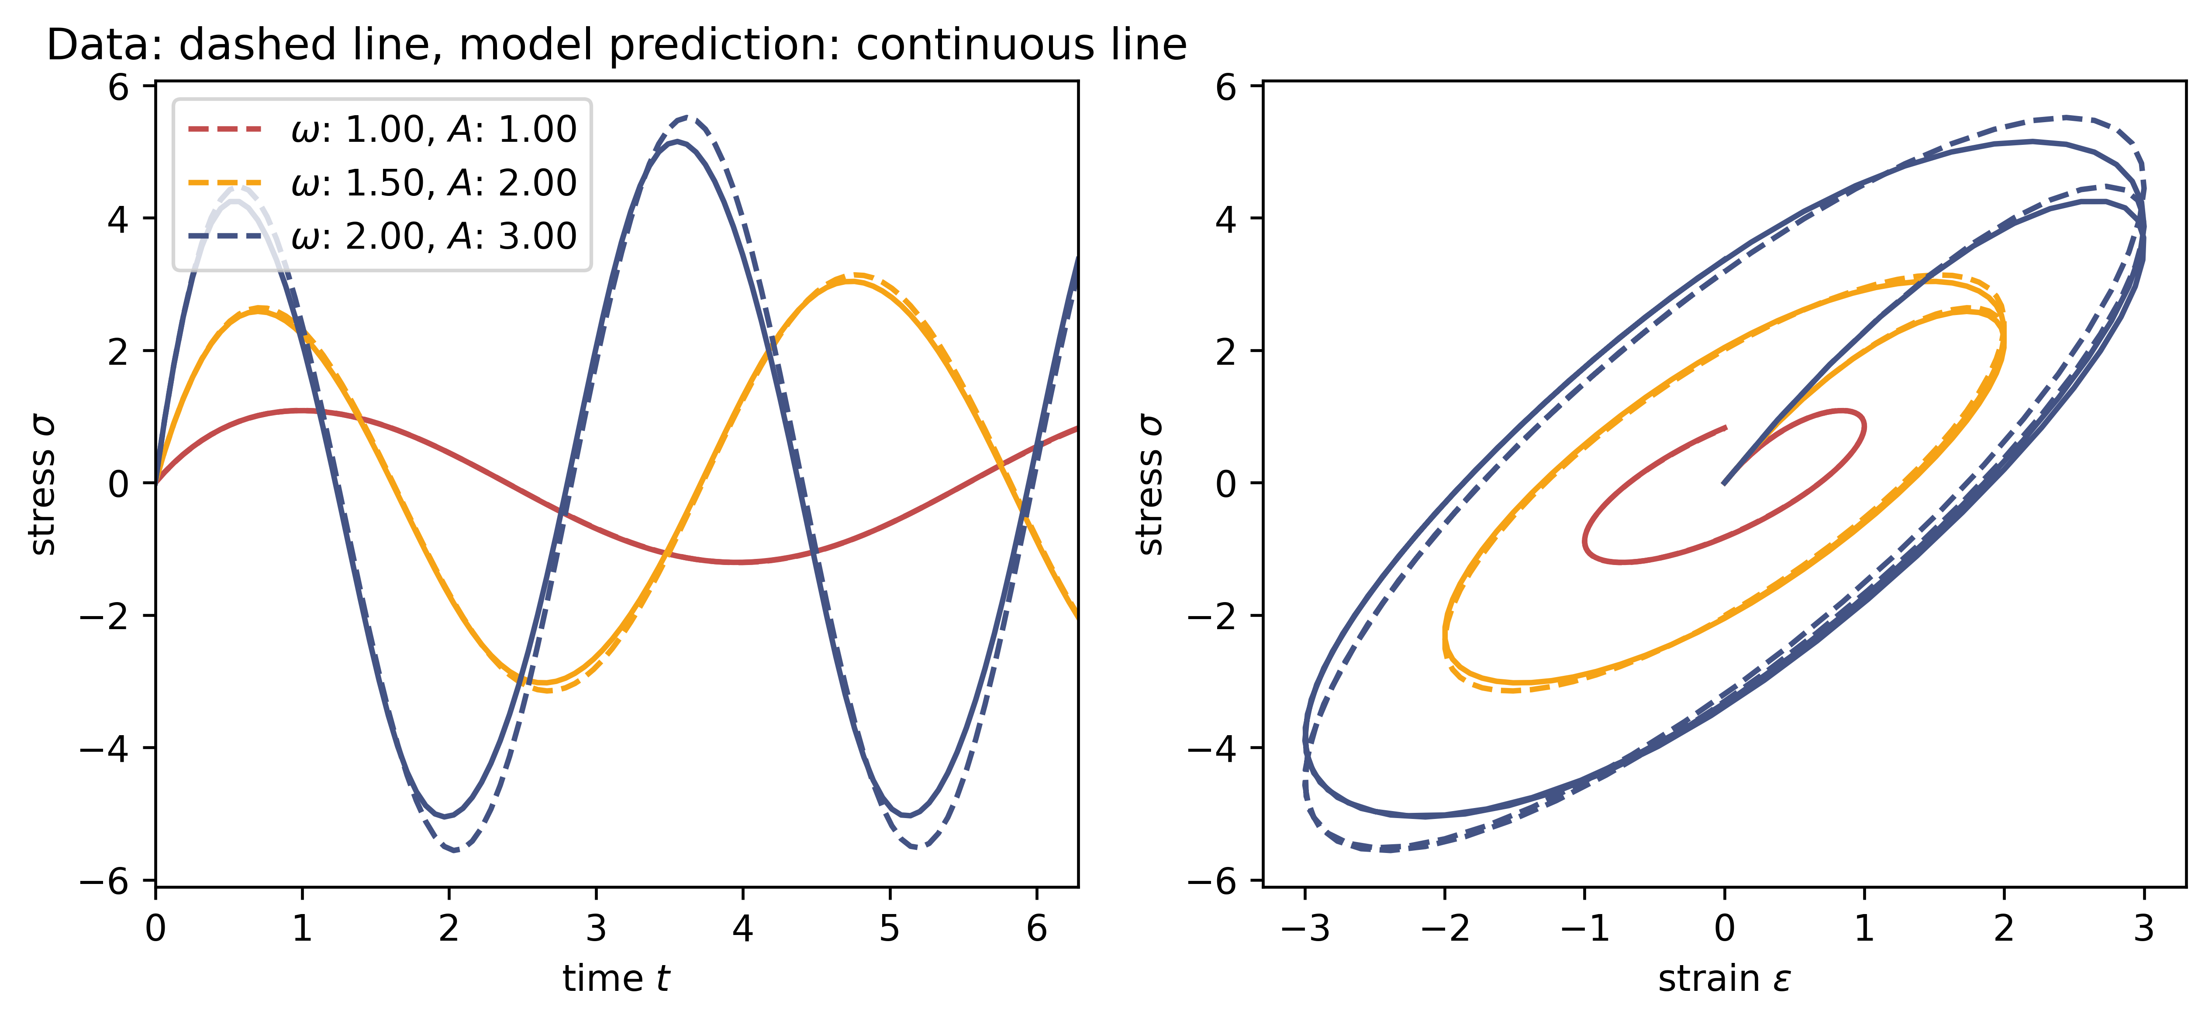
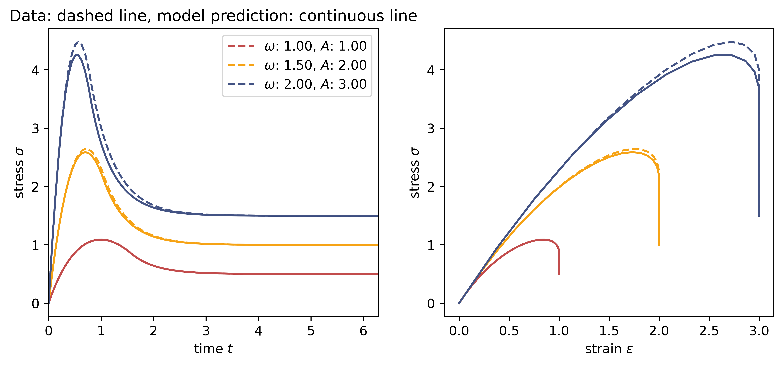
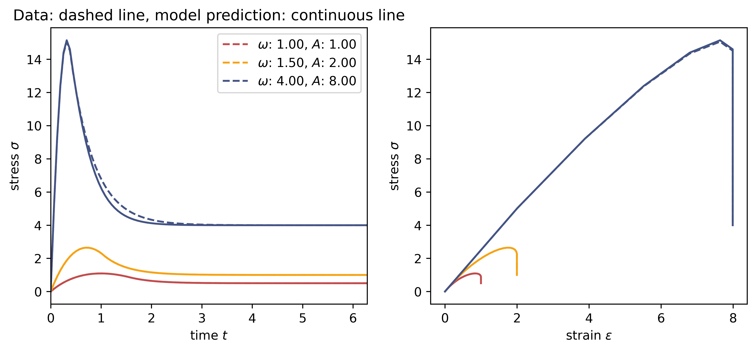
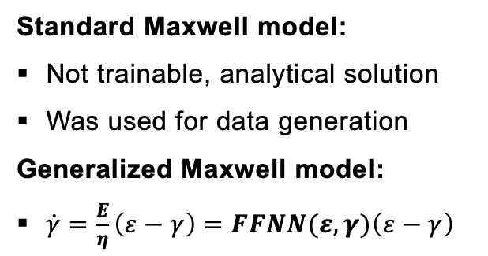
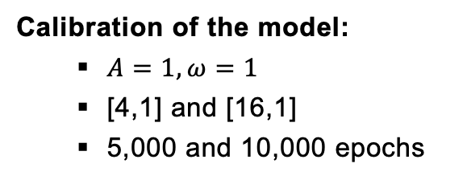
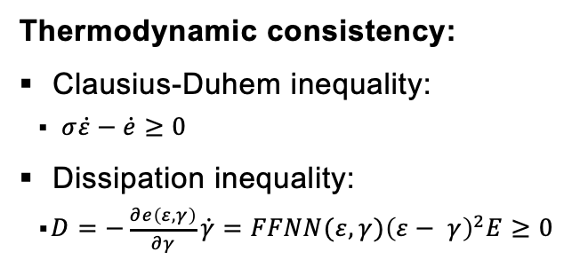
Introduction
Simple RNN
Maxwell Model
Generalized Standard Materials
Summary
Standard Maxwell model:
Not trainable, analytical solution
Was used for data generation
Generalized Maxwell model:
$\dot{γ}=\frac{E}{η}\left(ε−γ\right)=FFNN(ε,γ){\left(ε−γ\right)}^{}$
Calibration of the model:
$A=1, ω=1$
[4,1] and [16,1]
5,000 and 10,000 epochs
Thermodynamic consistency:
Clausius-Duhem inequality:
$σ\dot{ε}−\dot{e}≥0$
Dissipation inequality:
$D=−\frac{∂e\left(ε, γ\right)}{∂γ}\dot{γ}=FFNN(ε,γ){\left(ε− γ\right)}^{2}E≥0$
Standard Maxwell Model is our basis
GMM more flexible, but we only approx. a constant!
Extrapolation behavior increase with NN size
Notes:
-The first task consisted mainly of data preparation and data visualization
The data is generated synthetically by evaluating a hyperelastic potential
The dataset consists of triplets for the corresponding deformation gradient tensor F, the Stress tensor, and the strain energy density
We have different kind of deformation: uniaxial, biaxial, shear, mixed
A uniaxial load path is shown here as an example

Slide 5
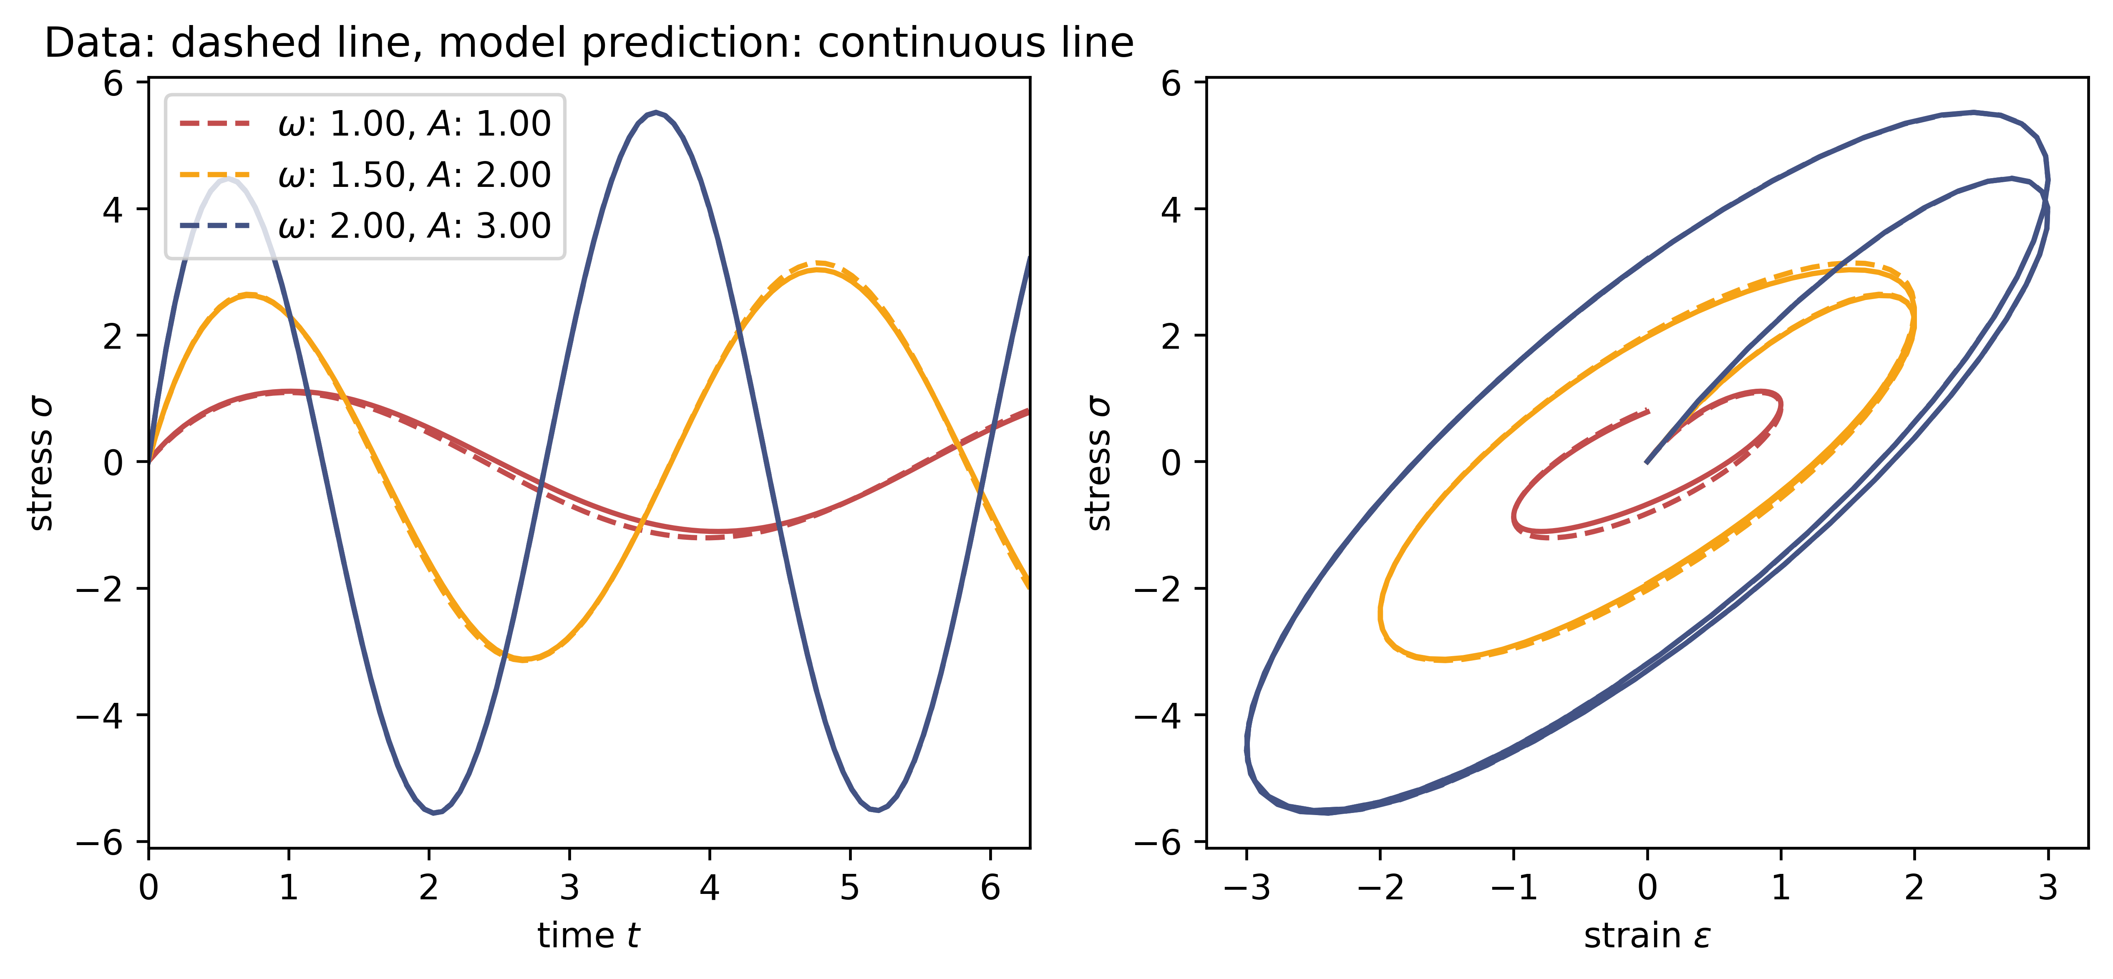
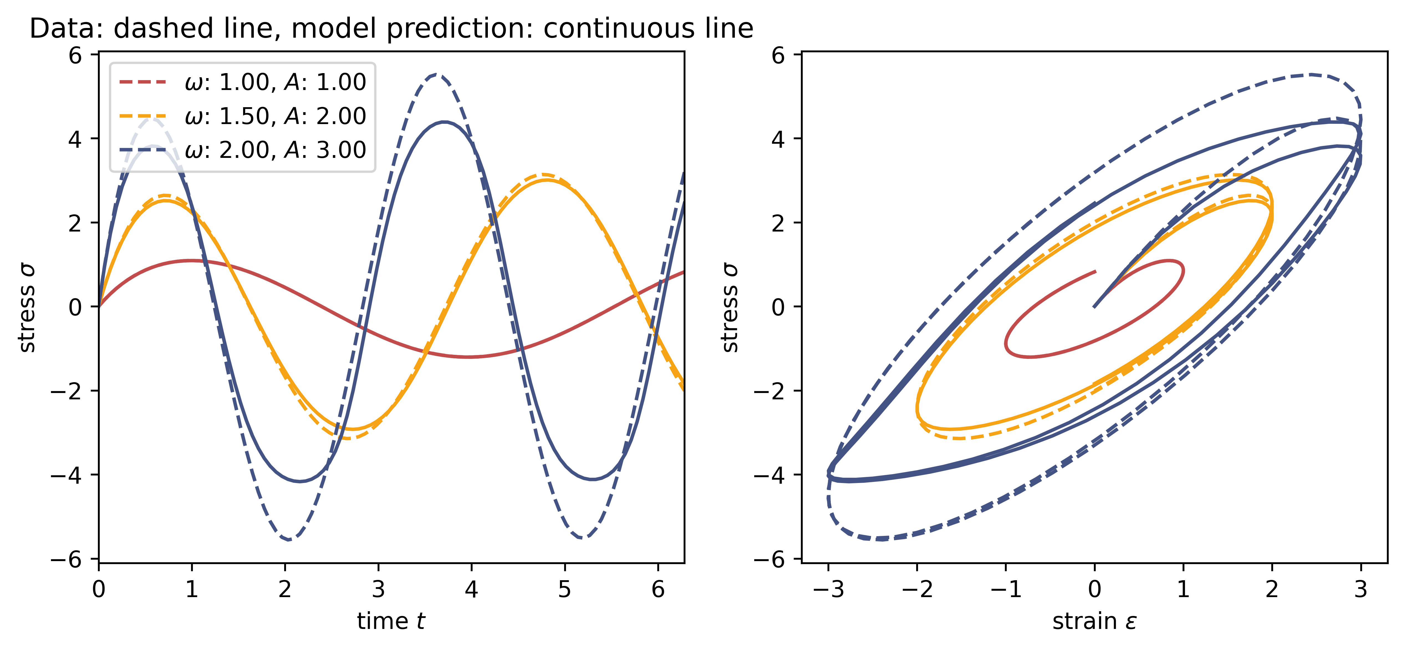
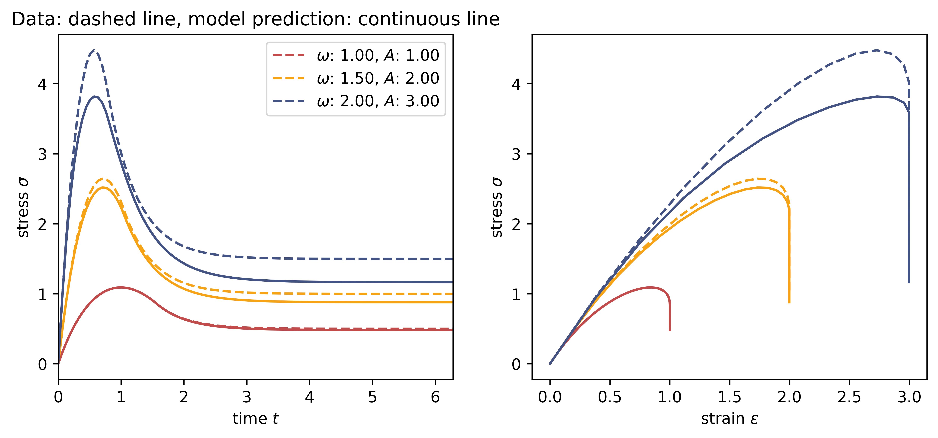
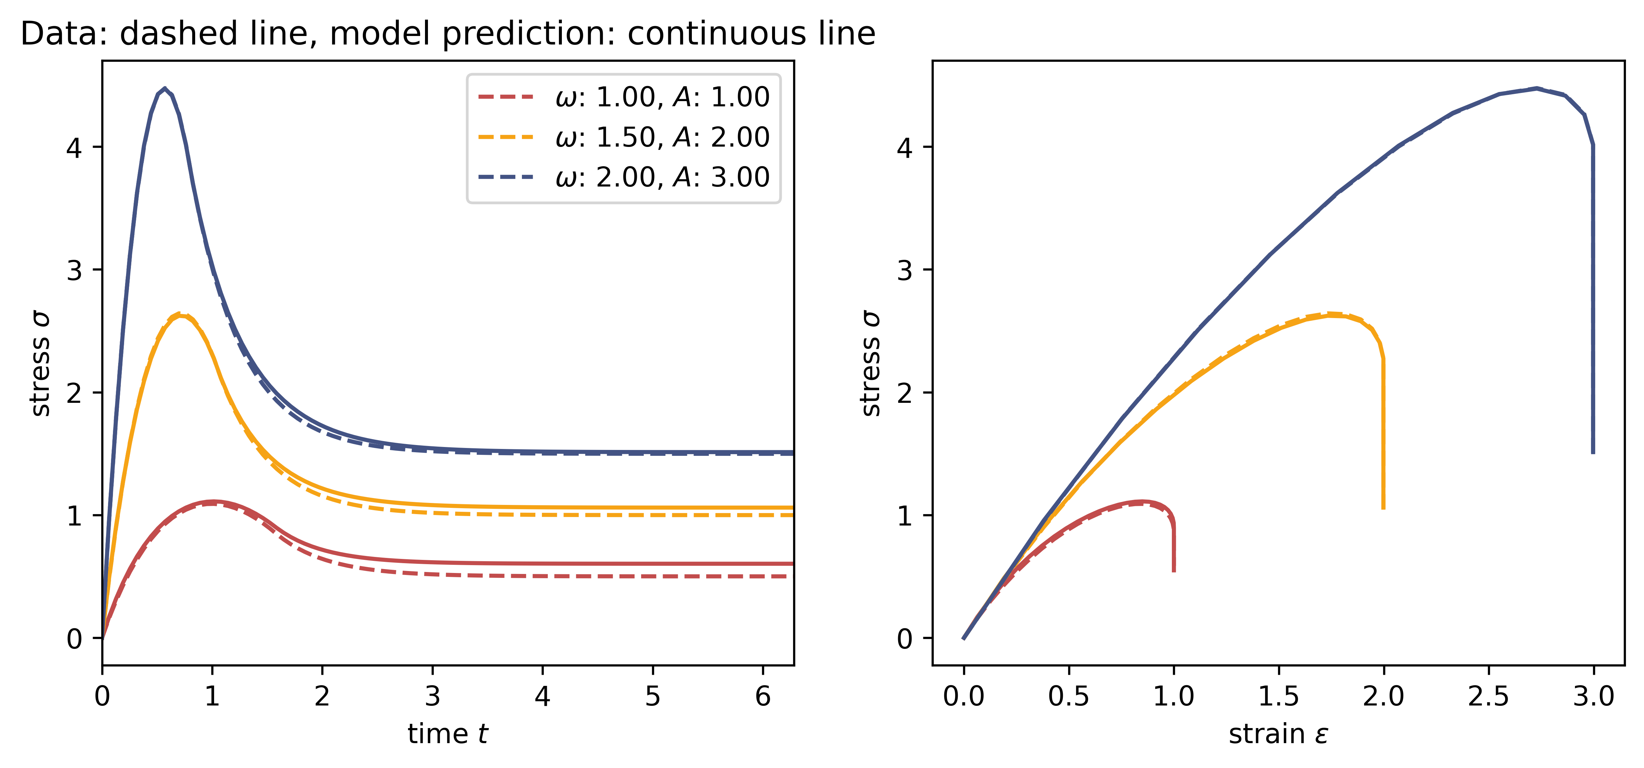
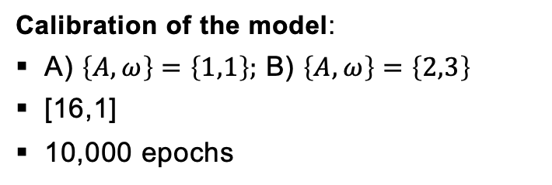
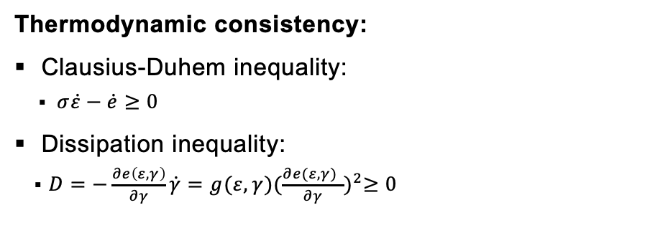
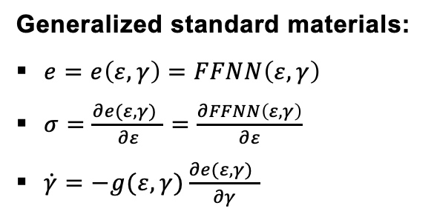
Introduction
Simple RNN
Maxwell Model
Generalized Standard Materials
Summary
Generalized standard materials:
$e=e\left(ε,γ\right)=FFNN\left(ε,γ\right)$
$σ=\frac{∂e(ε,γ) }{∂ε}=\frac{∂FFNN\left(ε,γ\right)}{∂ε}$
$\dot{γ}=−g(ε,γ)\frac{∂e(ε,γ) }{∂γ}$
Calibration of the model:
A) $\left\{A,ω\right\}=\left\{1,1\right\};$ B) $\left\{A,ω\right\}=\left\{2,3\right\}$
[16,1]
10,000 epochs
Thermodynamic consistency:
Clausius-Duhem inequality:
$σ\dot{ε}−\dot{e}≥0$
Dissipation inequality:
$D=−\frac{∂e\left(ε, γ\right)}{∂γ}\dot{γ}=g(ε,γ){(\frac{∂e(ε,γ) }{∂γ})}^{2}≥0$
Extrapolation very good if trained for larger amplitudes and frequencies
Thermodynamic consistancy is ensured through the dissipation potential
Not great influence of time
Notes:
-The first task consisted mainly of data preparation and data visualization
The data is generated synthetically by evaluating a hyperelastic potential
The dataset consists of triplets for the corresponding deformation gradient tensor F, the Stress tensor, and the strain energy density
We have different kind of deformation: uniaxial, biaxial, shear, mixed
A uniaxial load path is shown here as an example

Slide 6
Introduction
Simple RNN
Maxwell Model
Generalized Standard Materials
Summary
Simple RNN:
No prior knowledge
Extrapolation to unseen data is not perfect but acceptable.
Since time is an input parameter, the result is strongly dependent on time
Generalized Standard Materials:
Extrapolation very good if trained for larger amplitudes and frequencies
Thermodynamic consistancy is ensured through the dissipation potential
Not great influence of time
Notes:
-The first task consisted mainly of data preparation and data visualization
The data is generated synthetically by evaluating a hyperelastic potential
The dataset consists of triplets for the corresponding deformation gradient tensor F, the Stress tensor, and the strain energy density
We have different kind of deformation: uniaxial, biaxial, shear, mixed
A uniaxial load path is shown here as an example

Slide 7
Thank you for your attention!

Slide 8
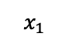
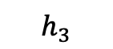
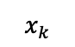
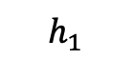
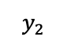
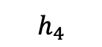
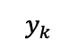
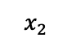
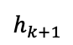
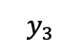
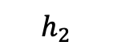
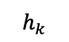
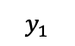
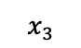
RNN
$$y_{1}$$
$$y_{2}$$
$$y_{3}$$
$$x_{k}$$
$$y_{k}$$
$$h_{1}$$
$$h_{2}$$
$$h_{3}$$
$$h_{4}$$
FFNN
FFNN
FFNN
$$h_{k}$$
$$h_{k+1}$$
$$x_{1}$$
$$x_{2}$$
$$x_{3}$$
FFNN
Notes:
-The first task consisted mainly of data preparation and data visualization
The data is generated synthetically by evaluating a hyperelastic potential
The dataset consists of triplets for the corresponding deformation gradient tensor F, the Stress tensor, and the strain energy density
We have different kind of deformation: uniaxial, biaxial, shear, mixed
A uniaxial load path is shown here as an example

